Slide 1
Zoro Local
An offline planner and journal
Hackathon / Offline Personal AI Agent

Slide 2
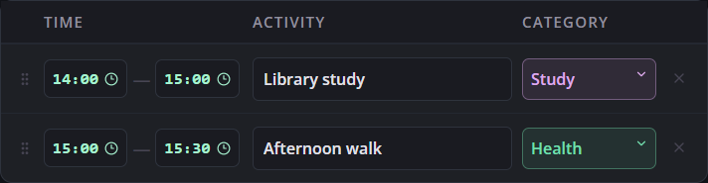
Tomorrow’s plan
The night before, you choose what to do and when.
Zoro can review the schedule before you save it.

Slide 3
What happened during the day?
Example study session
60 minutes
37 minutes
Planned for reading
Recorded in a check-in
Day review shows both figures. Insights tracks check-ins over time.

Slide 4
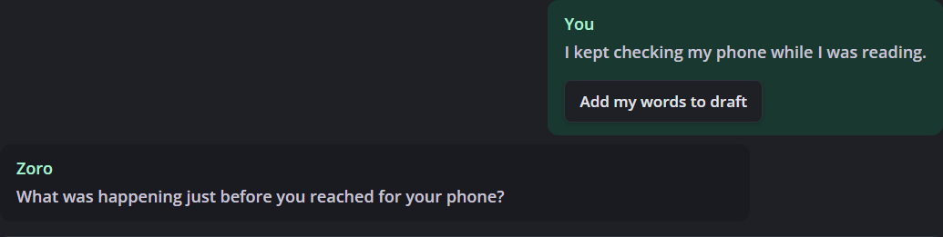
A conversation in your journal
Write what was on your mind. Zoro can ask a follow-up,
and you can keep your own words in the journal draft.

Slide 5
How Zoro works offline
On your laptop
The desktop app saves your plans, updates and journal by date.
Local AI
Ollama runs Qwen to review a plan or respond in your journal.
Past entries
Ask about a previous day. Zoro can look up the record or search your notes by meaning.

